Slide 1
Preparing for the PSAT
National Merit Scholarship Qualifying Test

Slide 2
How to Prepare for the PSAT
Step 1: Take a Practice Test! You can do this online or with your test booklet.
1
Step 2: Score your practice test and evaluate where you stand.
2
Step 3: Understand why you earned your score & build understanding
3
Step 4: Strategize your next steps by watching an expert webinar
4

Slide 3
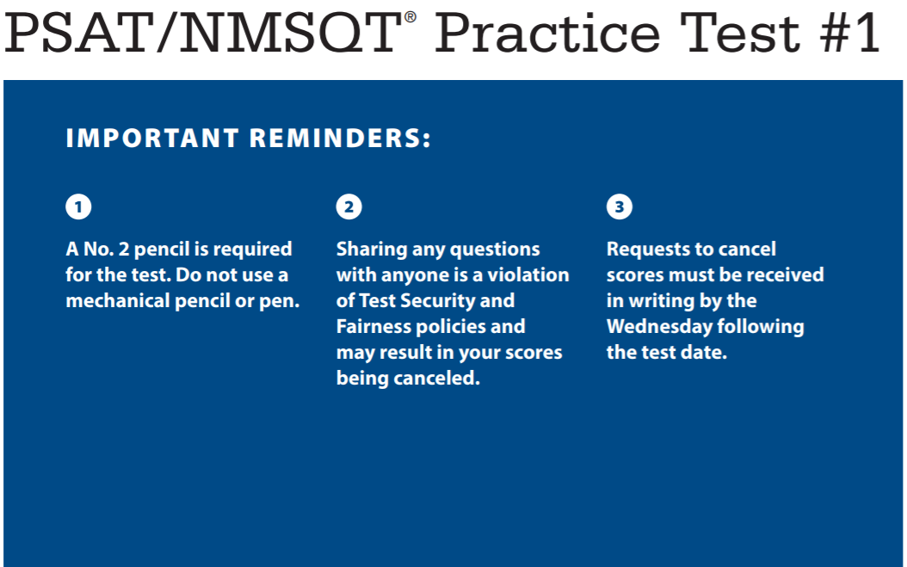
Step 1: Take a Practice TEST

Slide 4
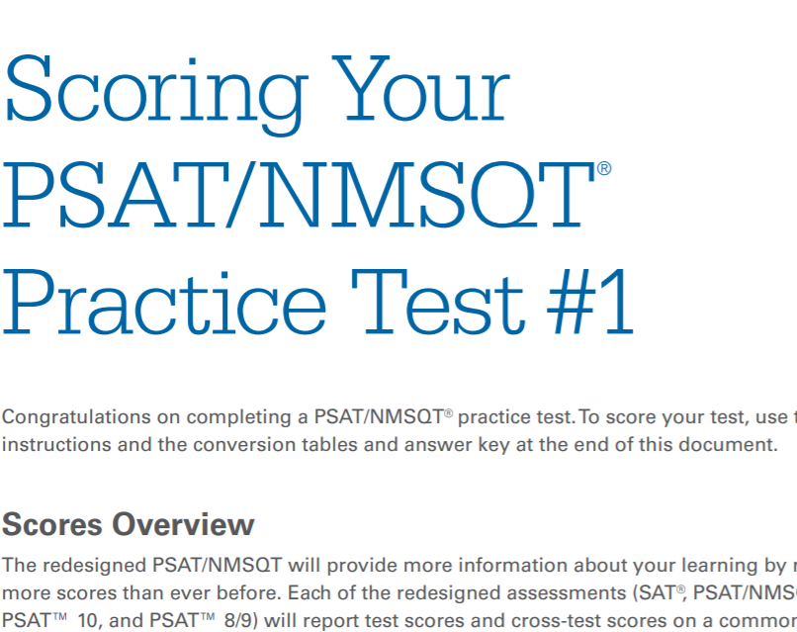
Step 2: REVIEW & Revisit

Slide 5
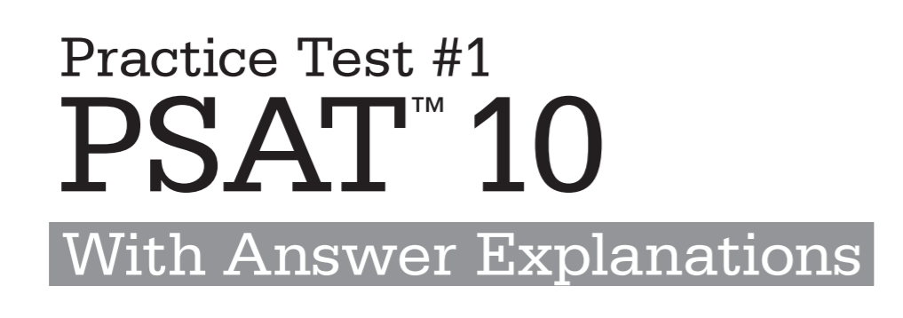
Step 3: Build Understanding

Slide 6

Step 4: strategize

Slide 7
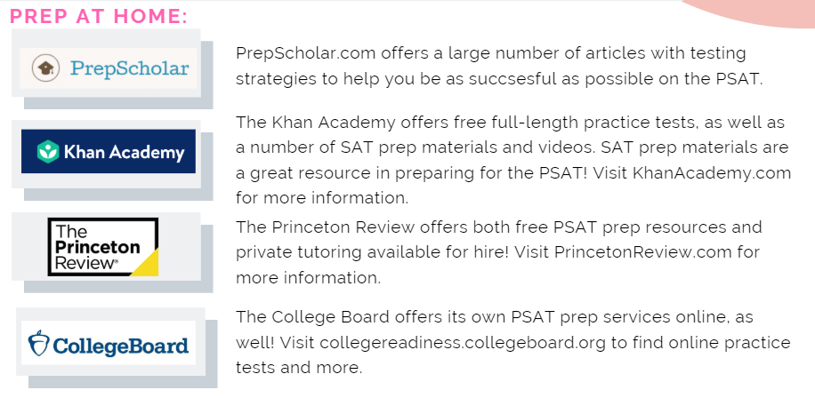
Additional Practice:

